Slide 1
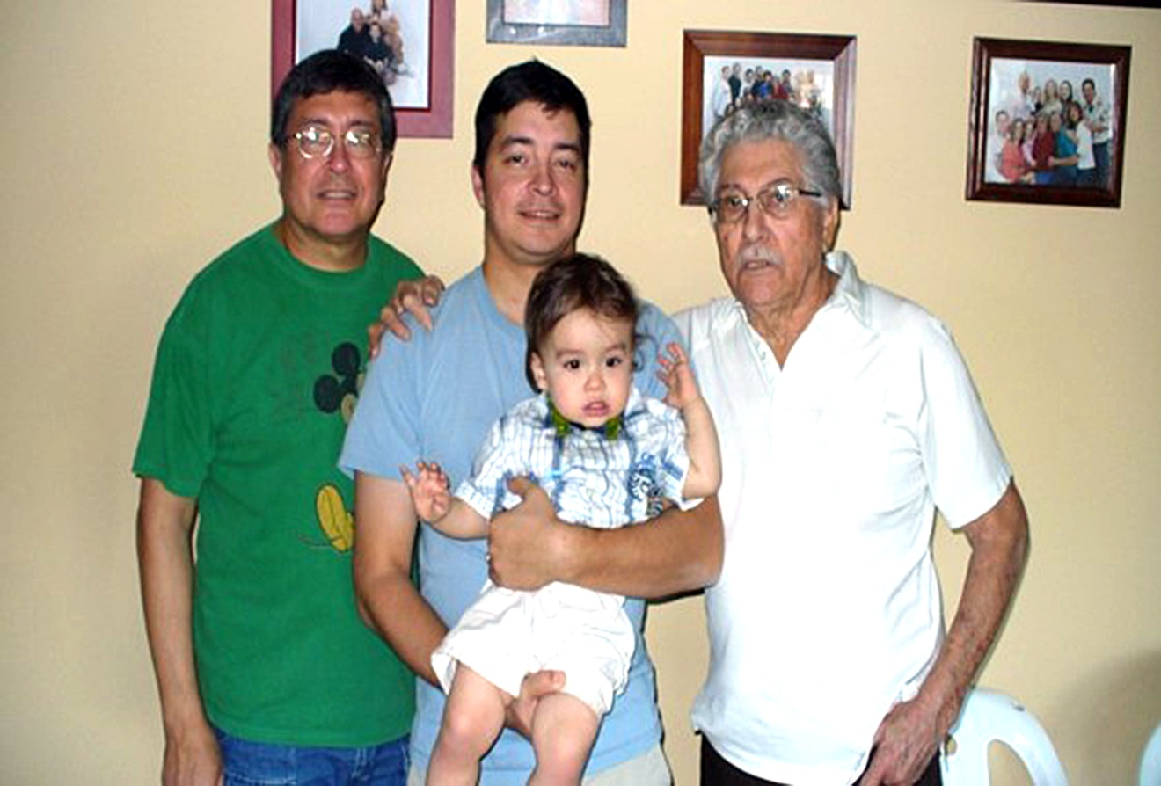
Multi-Generational Giving
Deacon Juan Sandoval jsandoval@stphilipscathedral.org

Slide 2
bingo

Slide 3
Watched the Beatles on “The Ed Sullivan Show” | Waited in line to buy gas during OPEC embargo | Is on Facebook | Has played more than 500 hours of Nintendo | Used a computer by age 10
Attended a day care center or kindergarten | Remembers when milk cost less than a dollar | Typed copy using carbon paper | Watched first-run episodes of “Gunsmoke” | Used a cell phone before the age of 20
Has never owned a record player | Watched first-run episodes of “Happy Days” | Can name three members of the Brat Pack | Knows who Zac Ephron is | Can name three members of the Rat Pack
Has own website or blog | Knows who Bing Crosby is | Watched the Who Shot JR? episode of “Dallas” | Remembers the moon landing | Watched “Sesame Street” as a child
Has parents who are divorced | Turned 30 before AIDS was identified | Listened to “The Lone Ranger” show on the radio | First voted at the age of 18 | Uses an iPhone or Android

Slide 4
small groups

Slide 5
Discuss the Photos of the Generation you are given.
Need Scribe for Discussion
Report out what you talked about
You have 10 Minutes

Slide 6

1922 - 1944
traditionalist

Slide 7
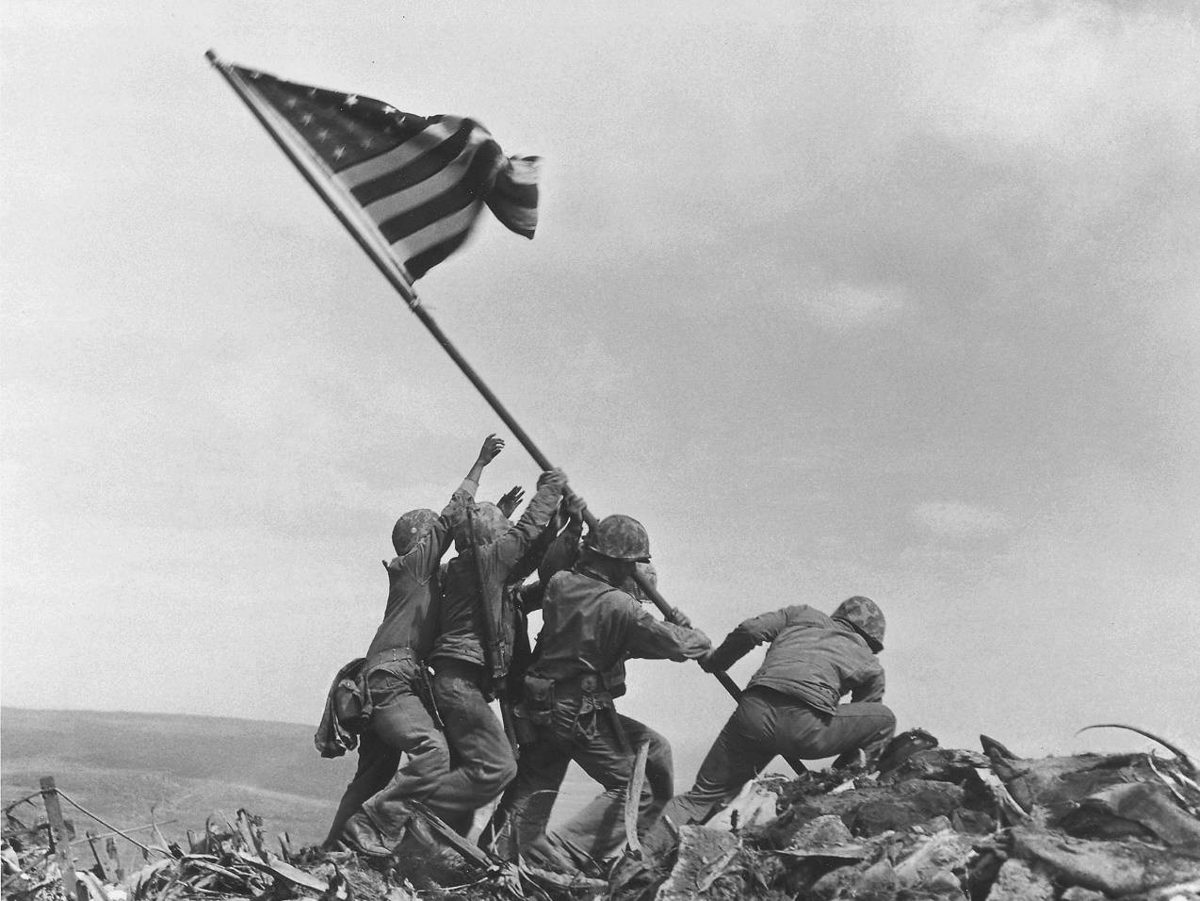
Traditionalist 1922 - 1944

Slide 8
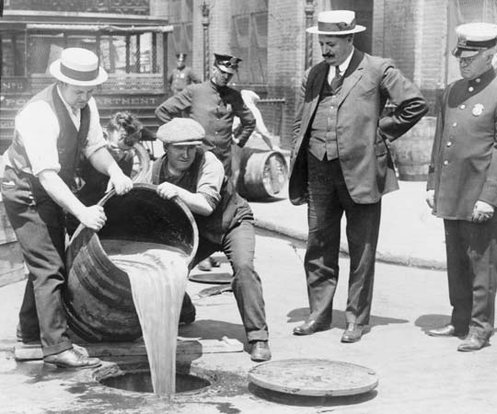
Traditionalist 1922 - 1944

Slide 9
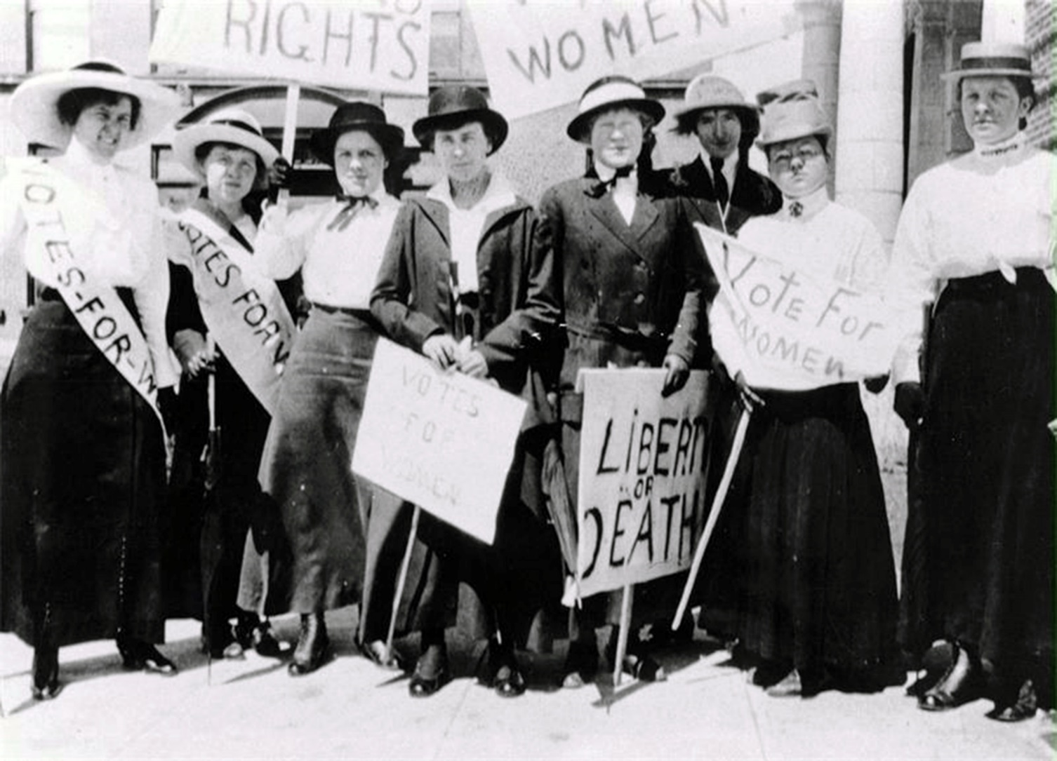
Traditionalist 1922 - 1944

Slide 10
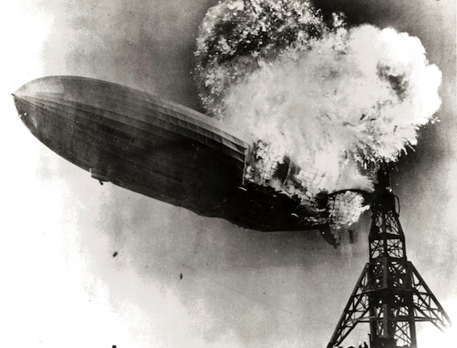
Traditionalist 1922 - 1944

Slide 11
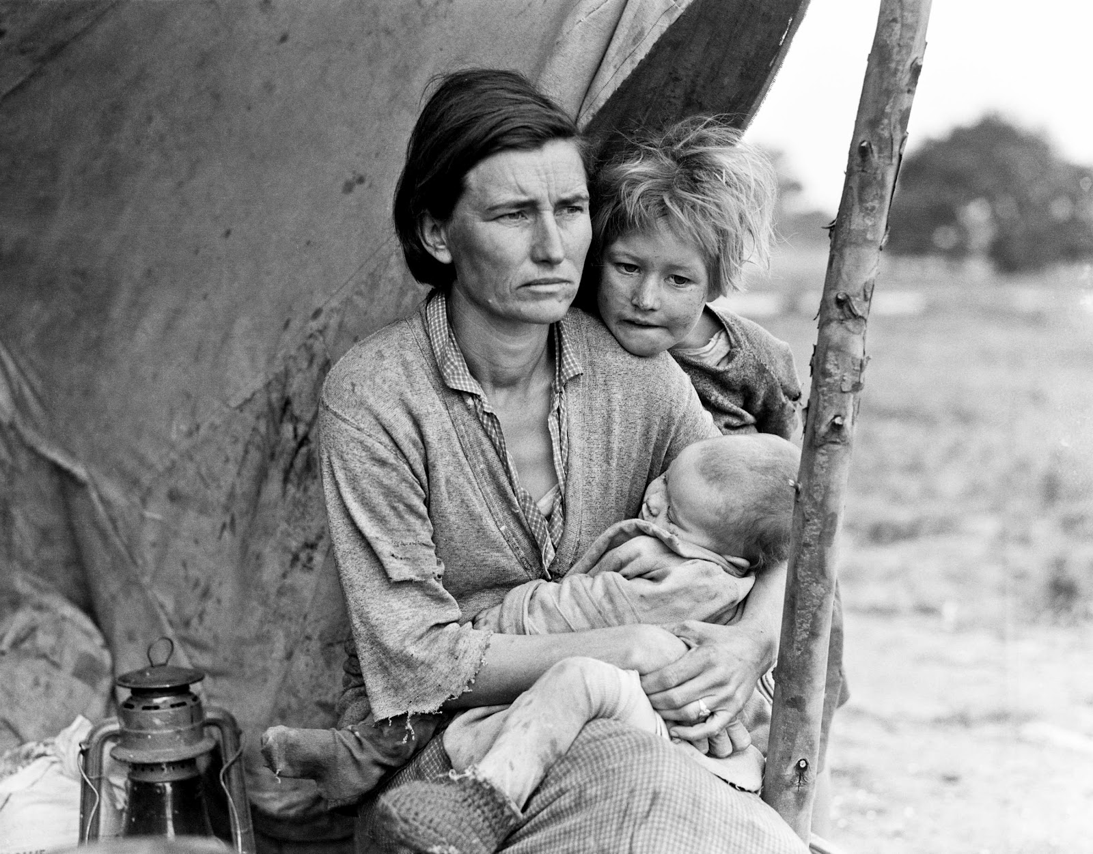
Traditionalist 1922 - 1944

Slide 12
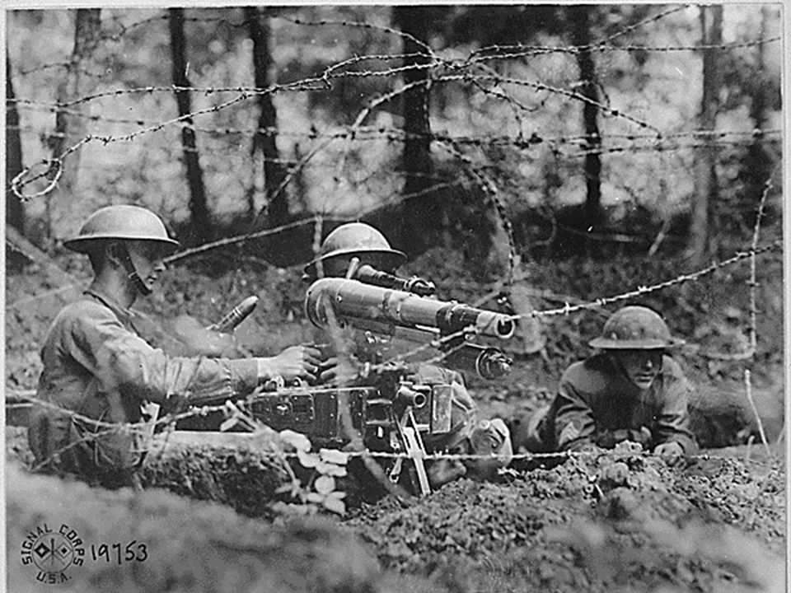
Traditionalist 1922 - 1944

Slide 13
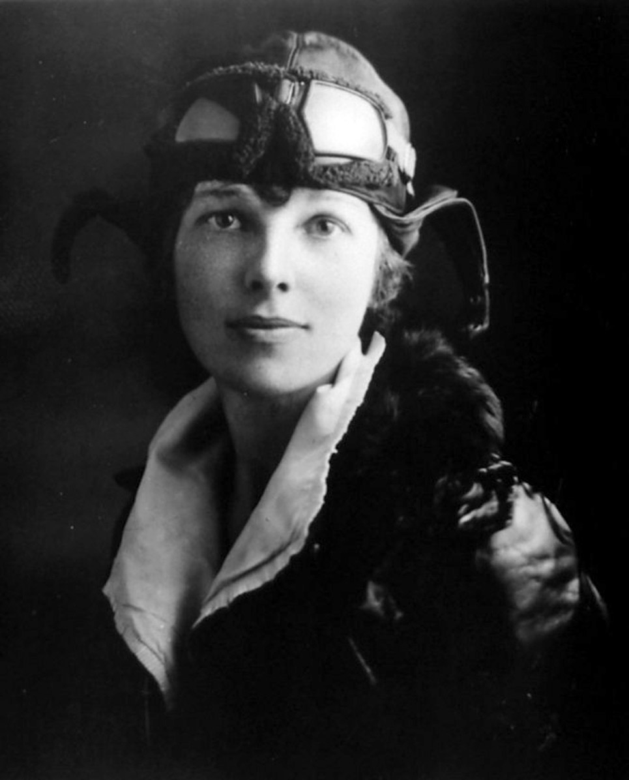
Traditionalist 1922 - 1944

Slide 14
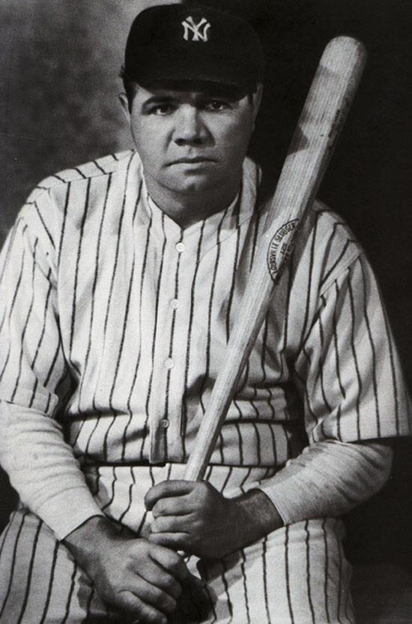
Traditionalist 1922 - 1944

Slide 15
Traditionalist 1922 - 1944

Slide 16
1945 - 1960
baby boomers

Slide 17
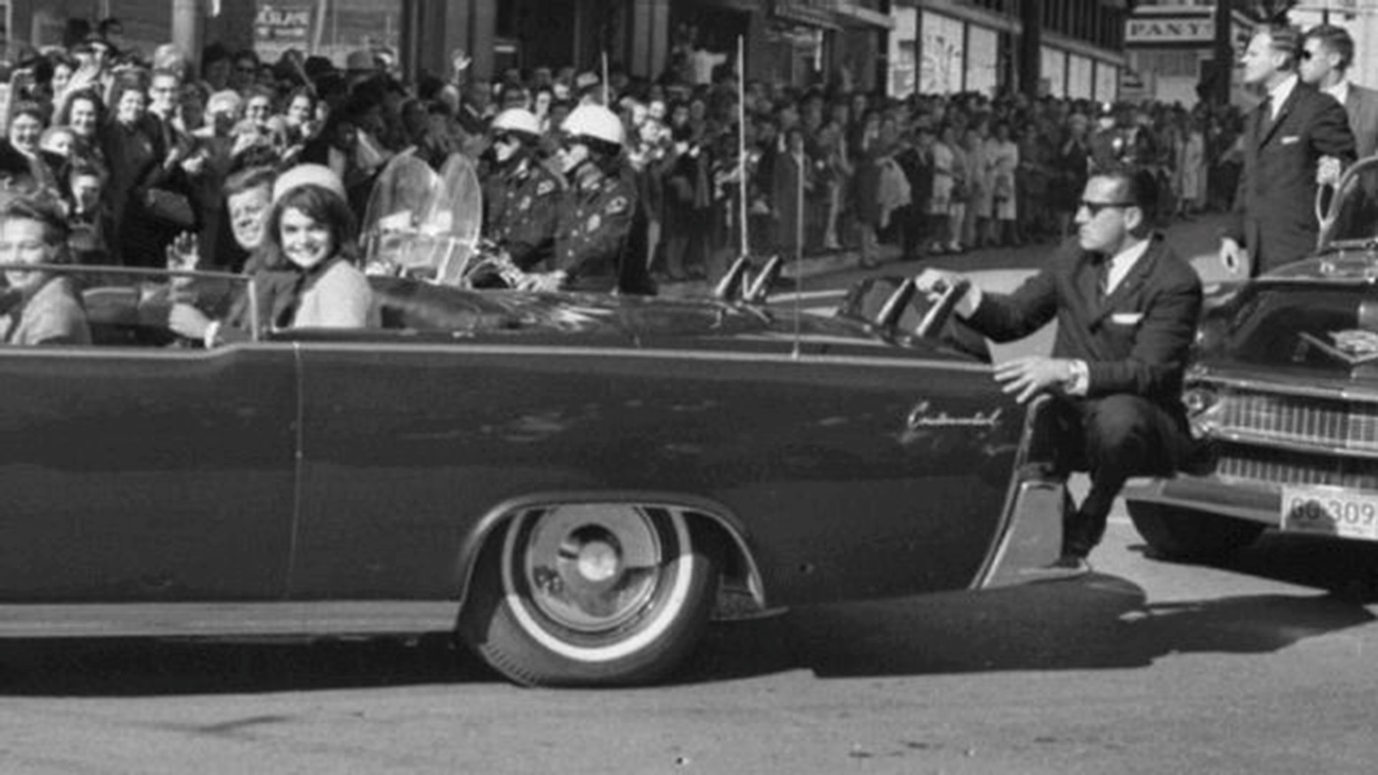
Baby Boomers 1945 - 1960

Slide 18
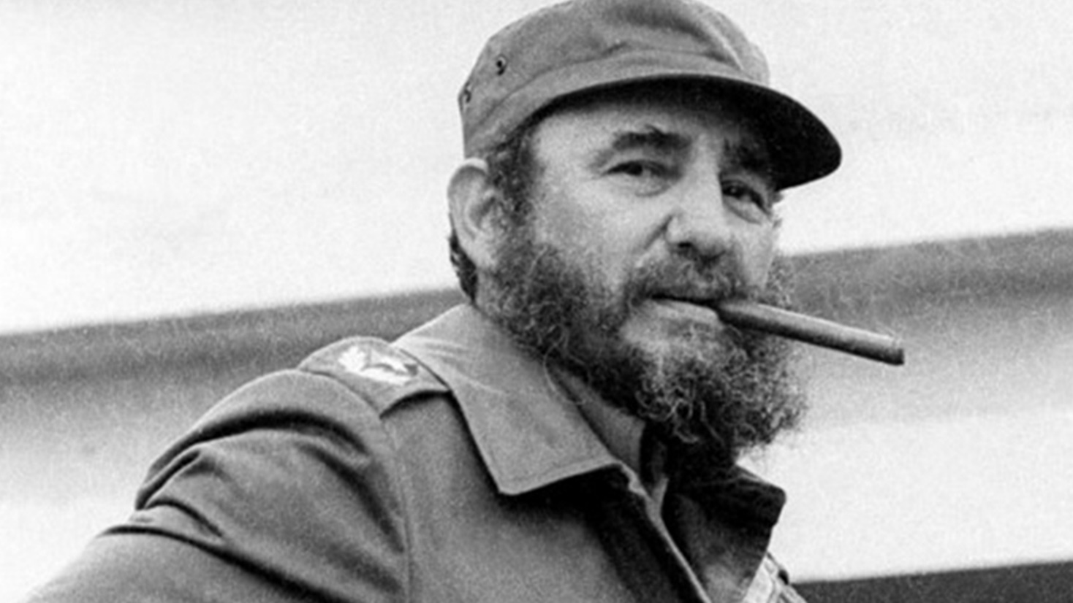
Baby Boomers 1945 - 1960

Slide 19
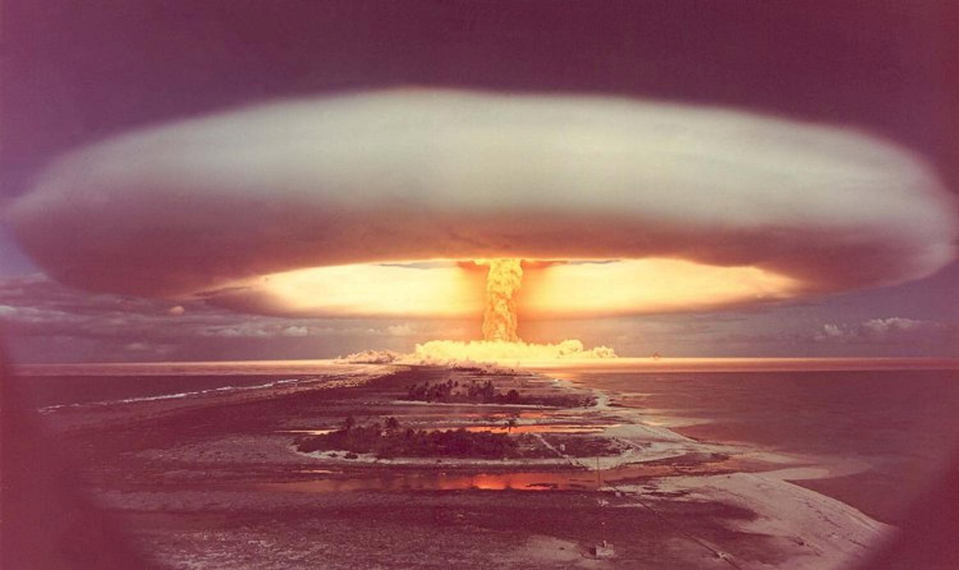
Baby Boomers 1945 - 1960

Slide 20
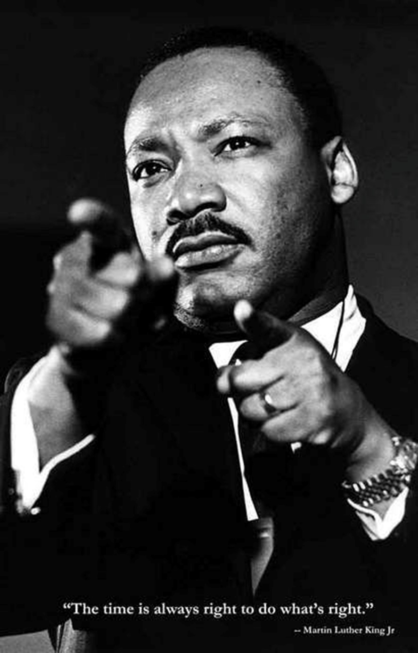
Baby Boomers 1945 - 1960

Slide 21
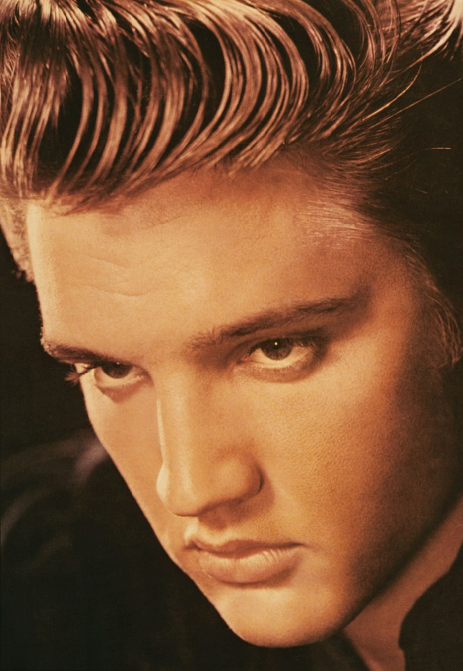
Baby Boomers 1945 - 1960

Slide 22

Baby Boomers 1945 - 1960

Slide 23
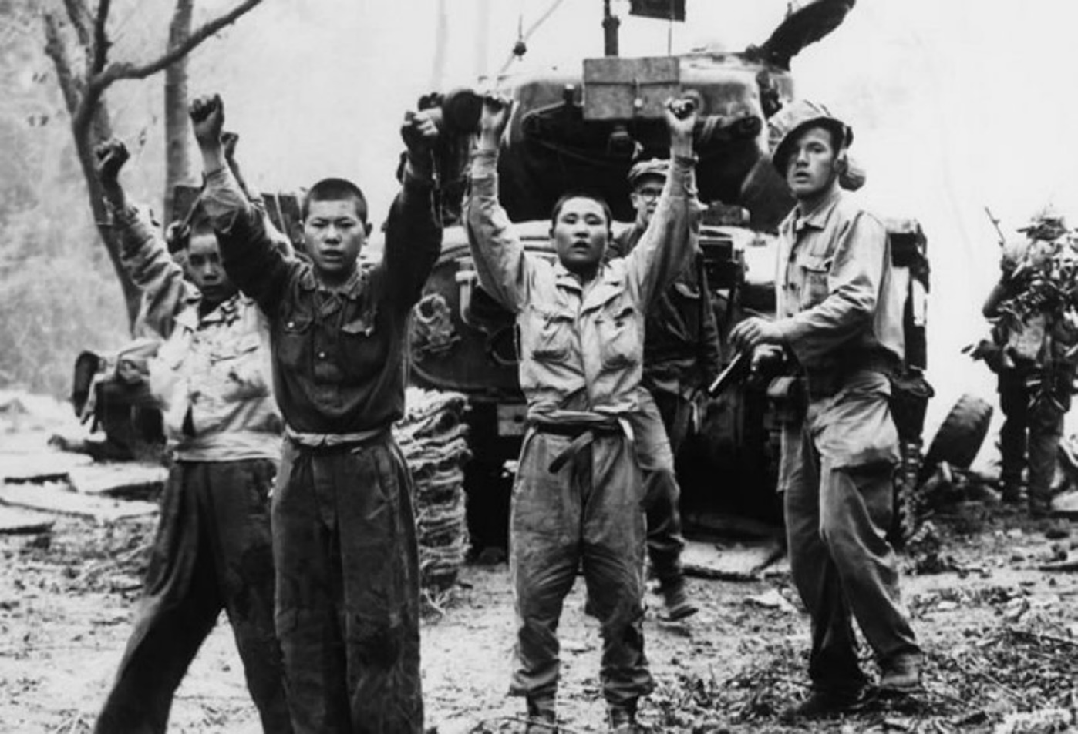
Baby Boomers 1945 - 1960

Slide 24
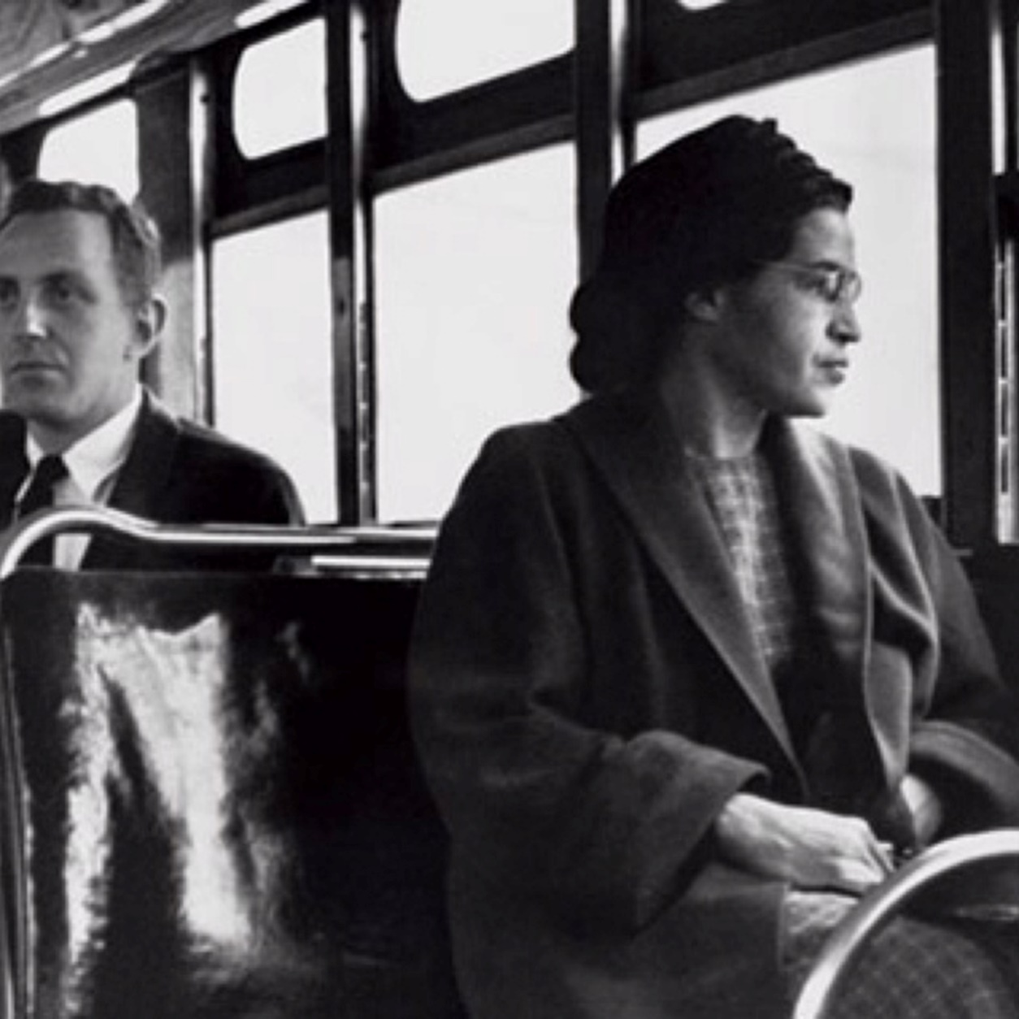
Baby Boomers 1945 - 1960

Slide 25
Baby Boomers 1945 - 1960

Slide 26
1961 - 1980
generation X

Slide 27
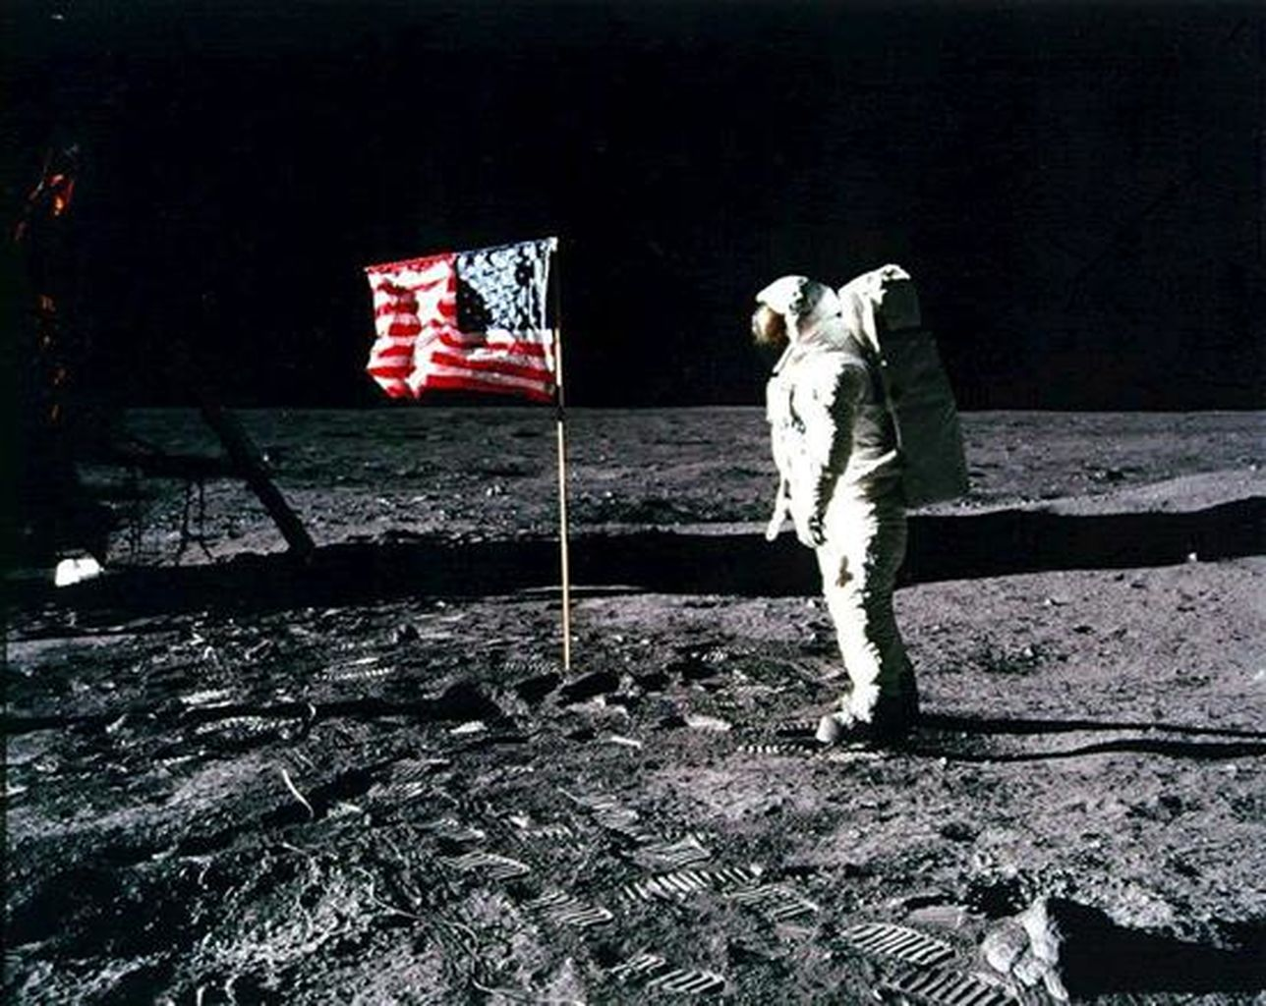
Generation X 1961 - 1980

Slide 28
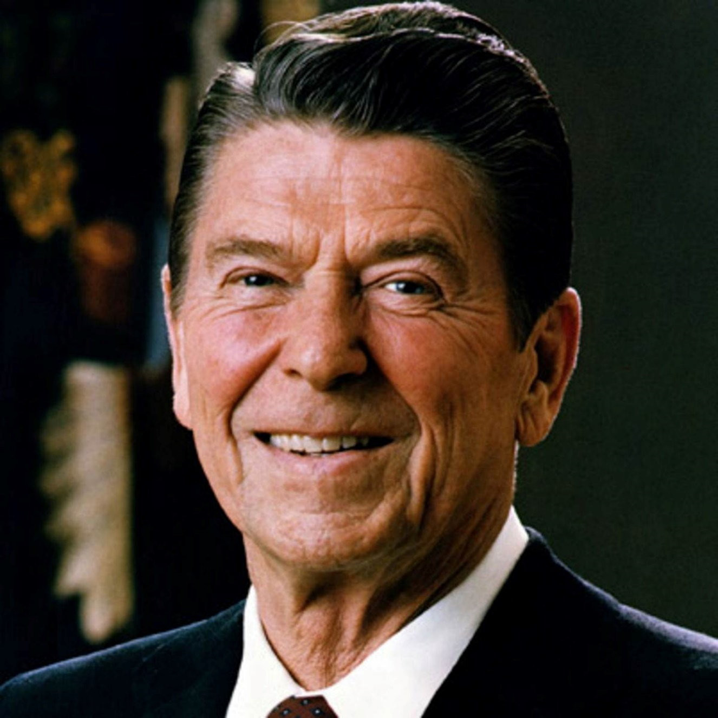
Generation X 1961 - 1980

Slide 29
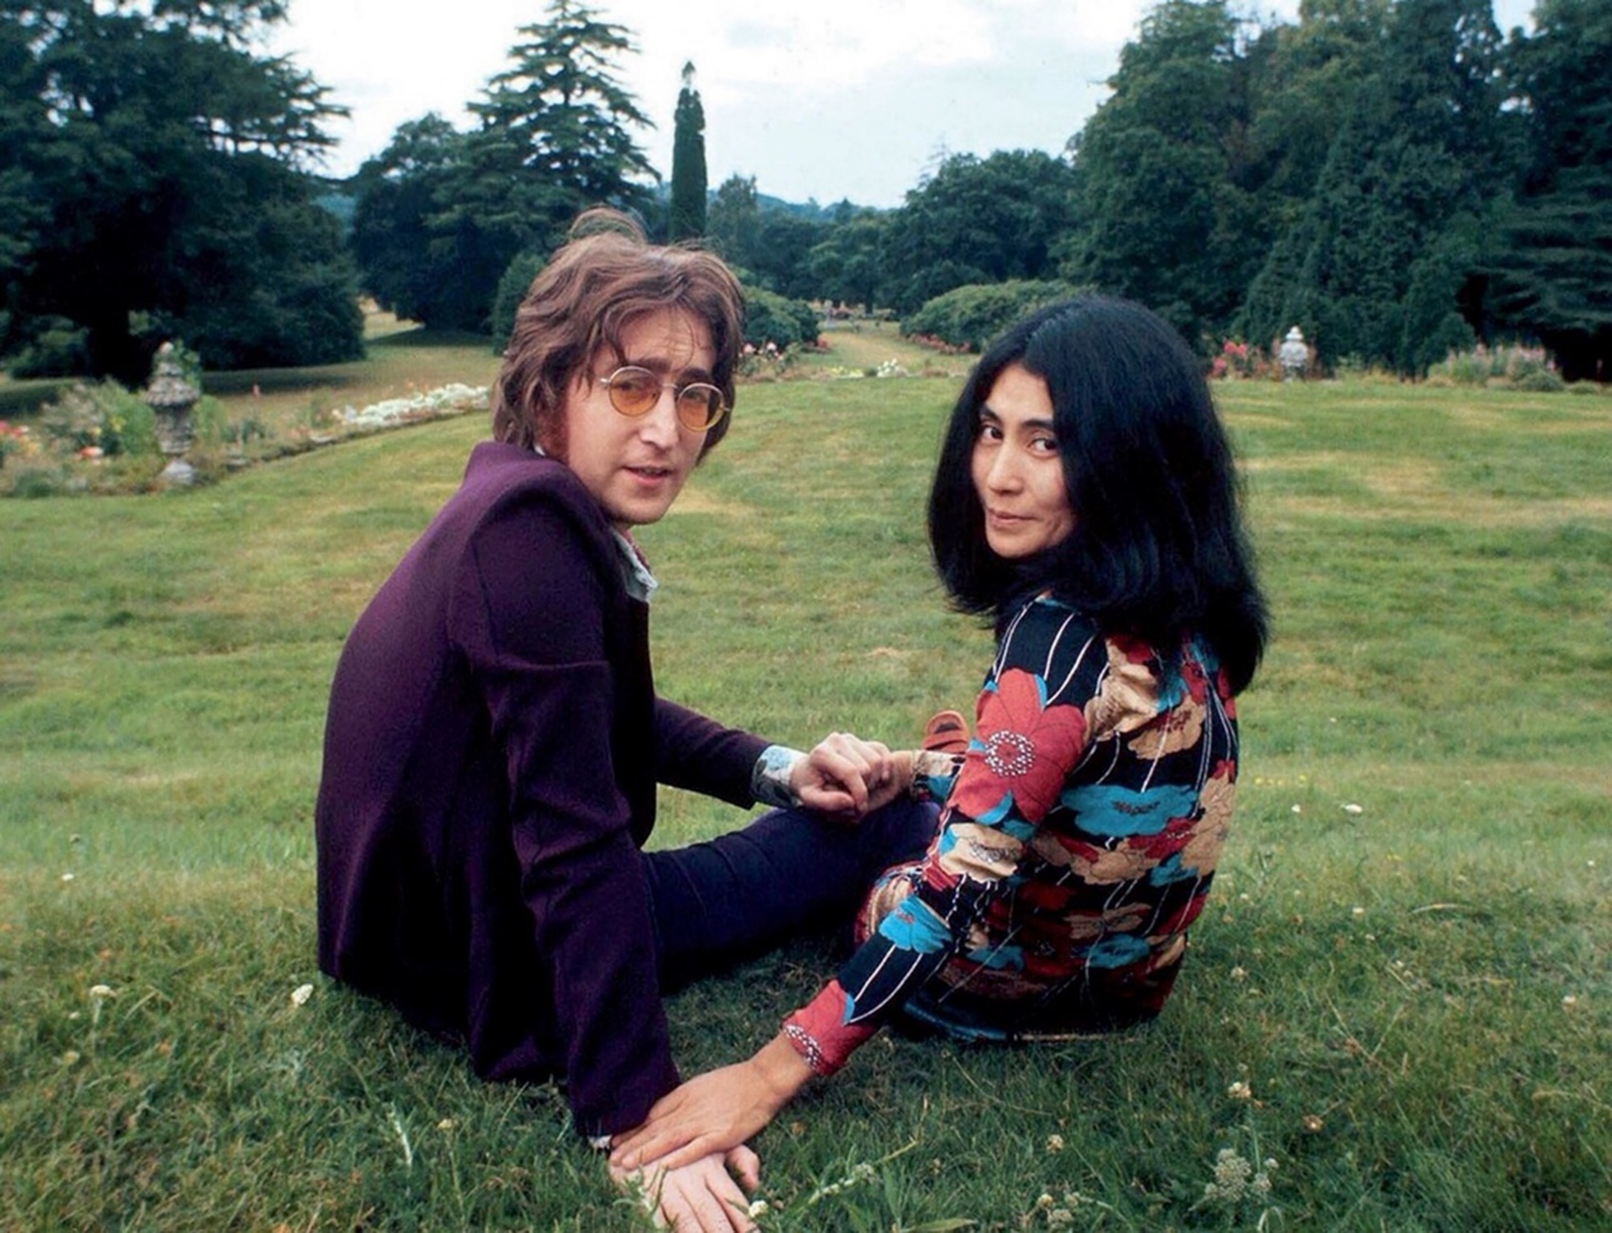
Generation X 1961 - 1980

Slide 30
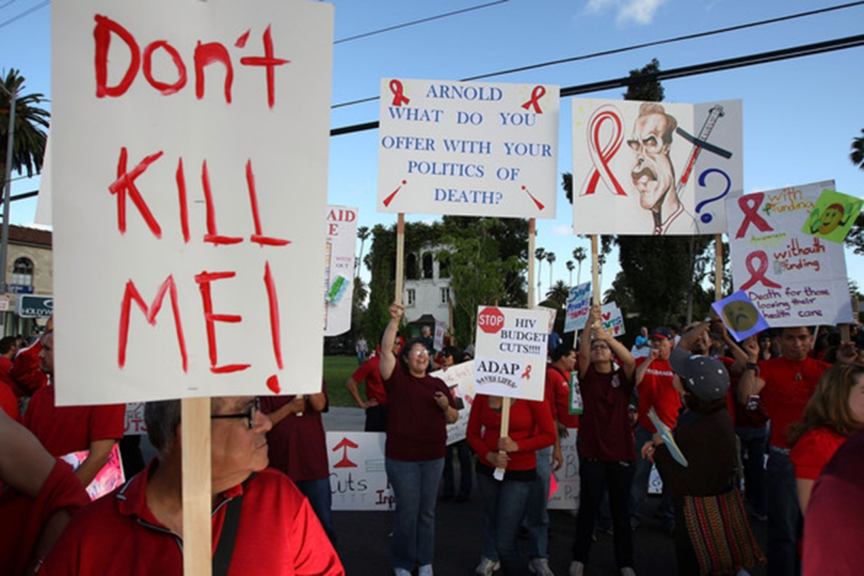
Generation X 1961 - 1980

Slide 31
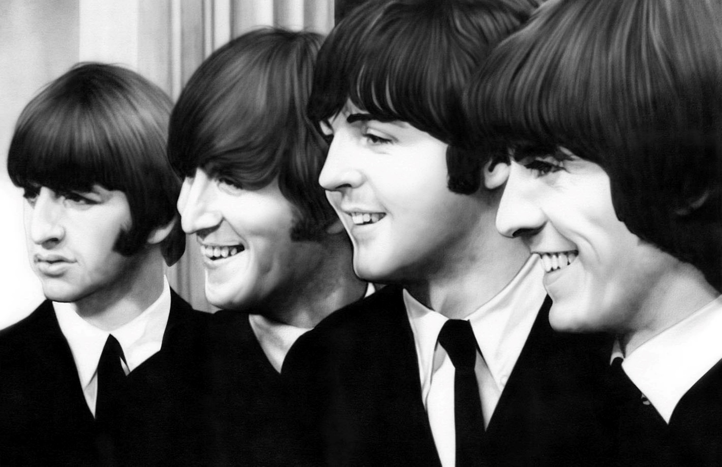
Generation X 1961 - 1980

Slide 32
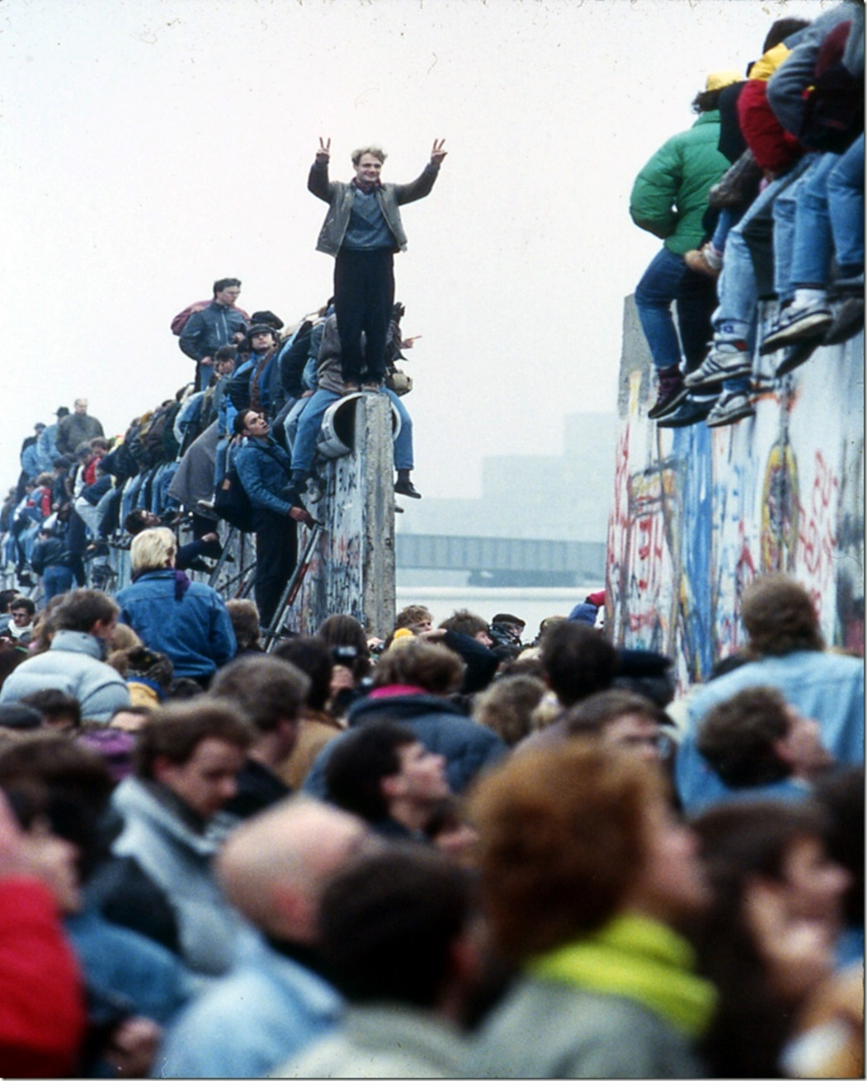
Generation X 1961 - 1980

Slide 33

Generation X 1961 - 1980

Slide 34
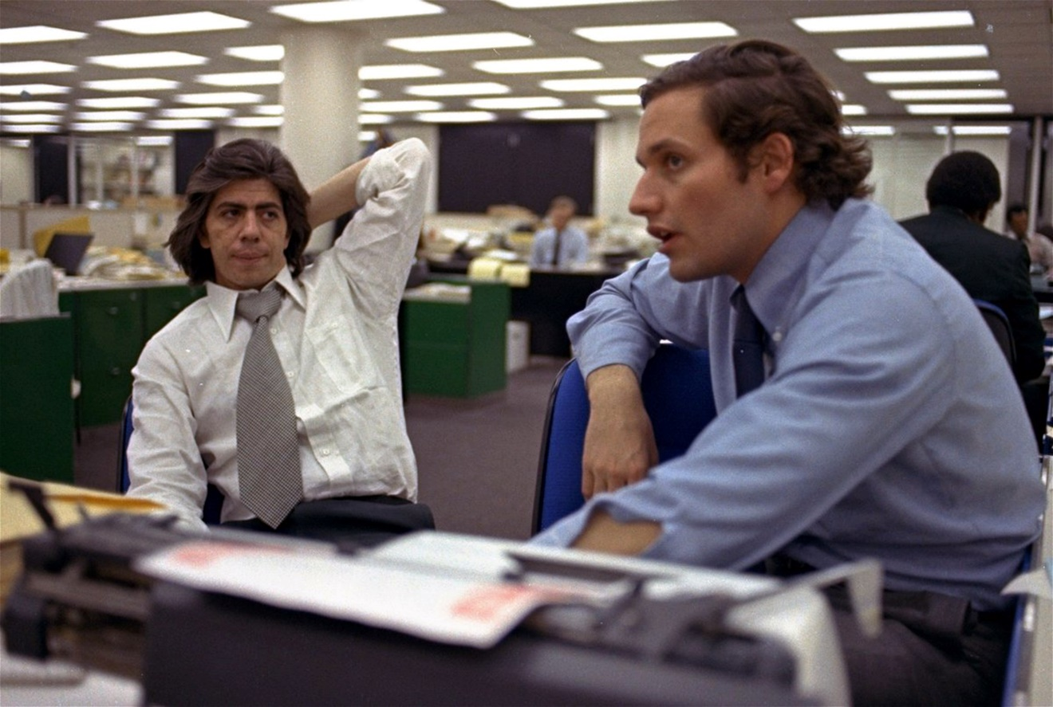
Generation X 1961 - 1980

Slide 35
Generation X 1961 - 1980

Slide 36
1981 - 2000
millennials/gen Y

Slide 37

Millennials / Gen Y 1981 - 2000

Slide 38

Millennials / Gen Y 1981 - 2000

Slide 39

Millennials / Gen Y 1981 - 2000

Slide 40
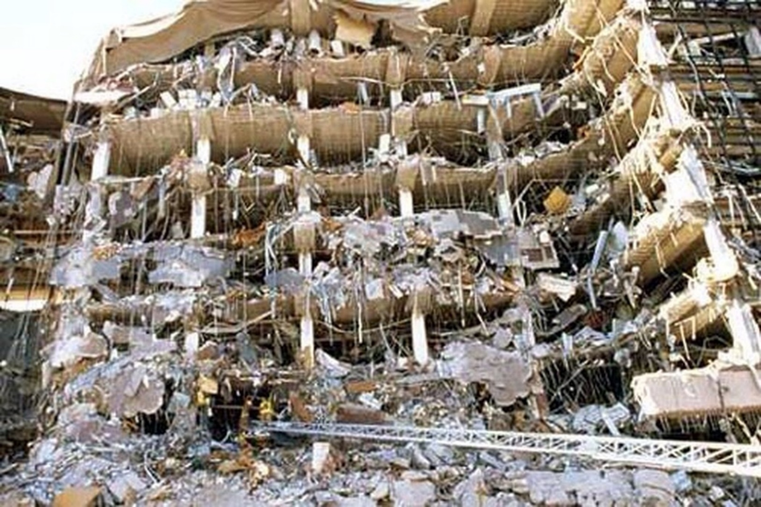
Millennials / Gen Y 1981 - 2000

Slide 41
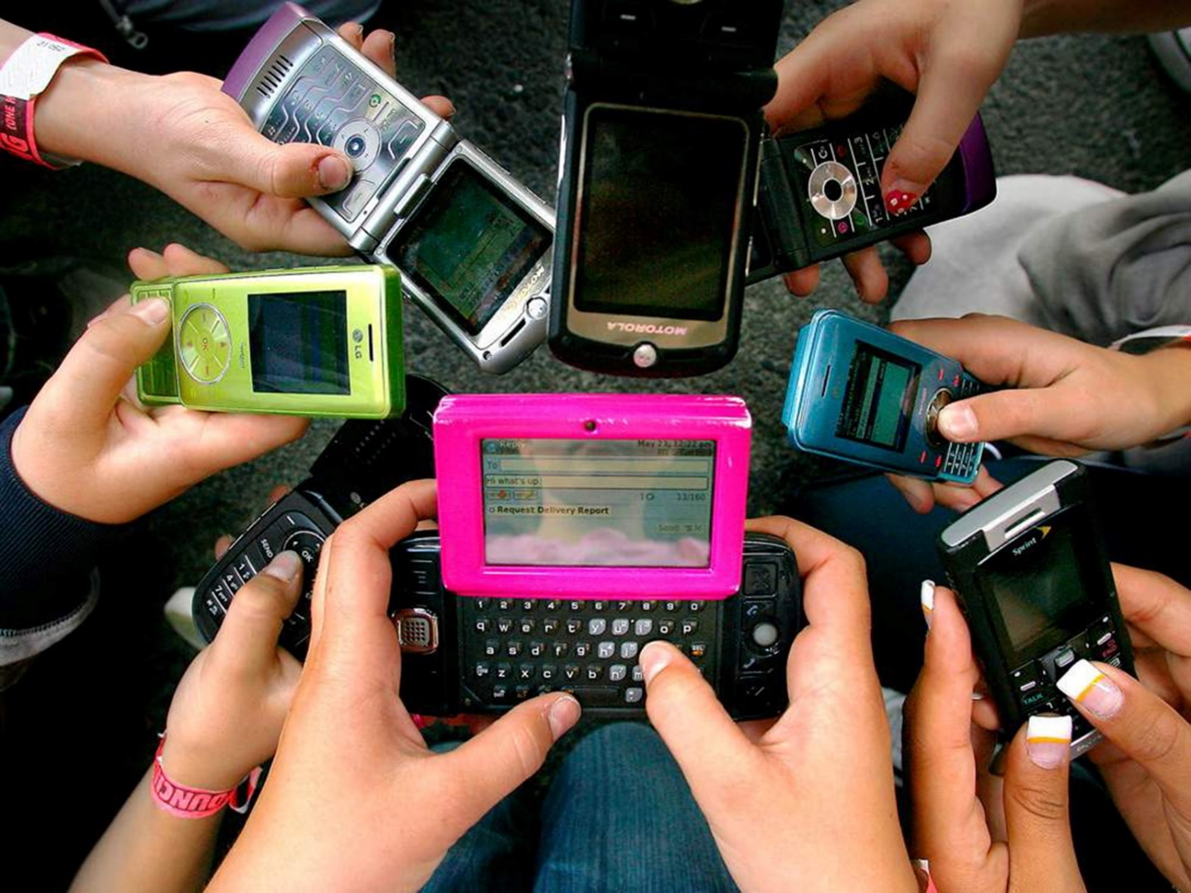
Millennials / Gen Y 1981 - 2000

Slide 42
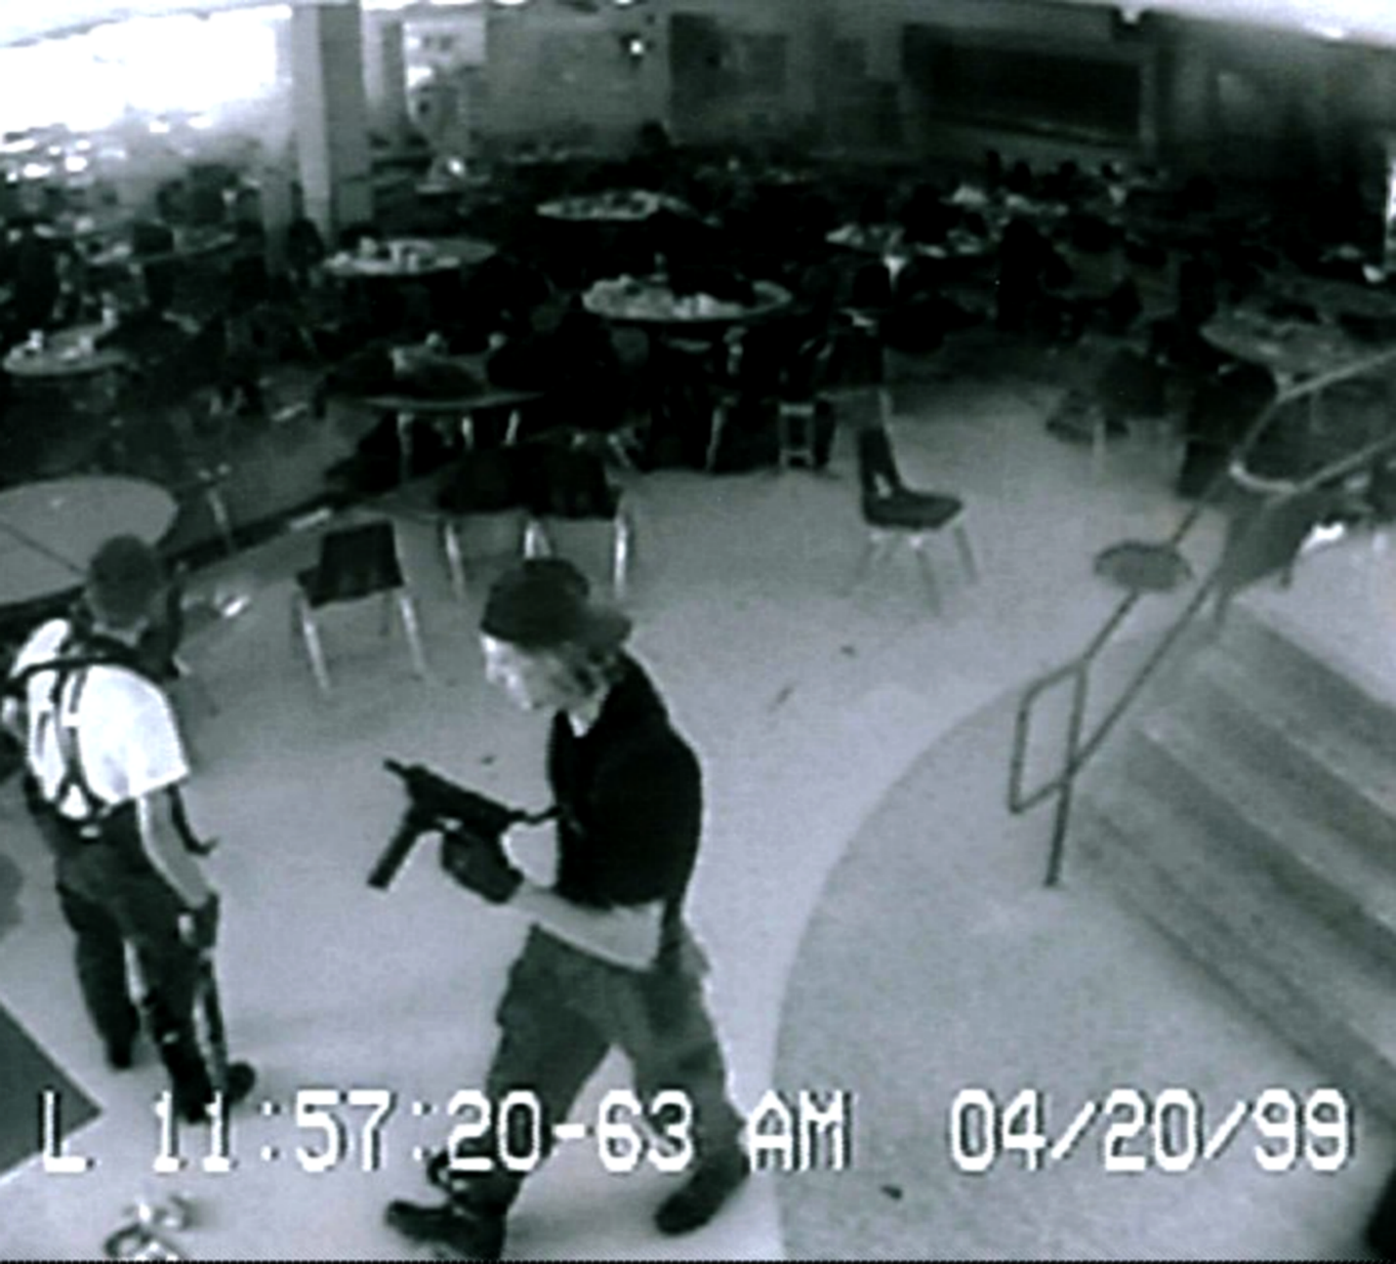
Millennials / Gen Y 1981 - 2000

Slide 43

Millennials / Gen Y 1981 - 2000

Slide 44
Millennials / Gen Y 1981 - 2000

Slide 45
Why Consider Generations
90% of our values are set by age 10
Our values reach final “lock-in” by age 20
The only way things change after that is through a “significant emotional event”
History shapes generations: common events and experiences create common values.
Generations shape history: the leadership of a generation changes the course of events.

Slide 46

1922 - 1944
traditionalist

Slide 47

Traditionalist 1922 - 1944
Children or young adults during Depression, WWII; after the war, settled down in prosperity
Value teamwork, conformity, respect for authority, hierarchy, fair play, honor
Take religious obligations seriously
Enjoy building for posterity
Value fair play, tolerance, compromise
Preference for relational consensus building

Slide 48
Traditionalist 1922 - 1944
Many are comfortably retired
Especially value relationships and friendships
Enjoy members of other generations
Value helping hands for marginalized
Modest, giving is often quiet
Value support of arts and outreach

Slide 49

1945 - 1960
baby boomers

Slide 50

Baby Boomers 1945 - 1960
GI Parents provided safe, prosperous world
Institutions were strong and stable
Children encouraged to express individuality
Establishing new paradigms for congregations
Seek personal spiritual experiences and freedom
Frequent conflicts over issues

Slide 51
Baby Boomers 1945 - 1960
Two-career families with older/grown children
Hard-working, complex schedules
Time is more precious than money
Need to understand the vision (not the budget)
Reluctant to commit: give them time!
Value environment and children

Slide 52

1961 - 1980
generation X

Slide 53

Generation X 1961 - 1980
Came of age as latchkey kids, children of divorce; learned how to fend for themselves
Uneven economic times, instability – work to live, not live to work
Distrust of institutions and authority – want authenticity, not sugar coating
Prefer task forces to long term
Visually oriented – want interactive experiences

Slide 54
Generation X 1961 - 1980
Often have little religious background or coherence – grow up wary and skeptical; need religious education
Discretionary income is at minimum: low incomes, high debt loads, young children
Hard-working, little extra time
Search for community they lack
Action-oriented

Slide 55

1981 - 2000
millennials/gen Y

Slide 56

Millennials 1981 - 2000
Born at time of rekindled interest in children – emphasis on protection, safety, health
Rules, respect, responsibility, right and wrong
Teamwork, problem-solving
Powerful, capable, competent achievers

Slide 57
Millennials 1981 - 2000
Take religious obligations seriously
Yearning for calm inner world
Desire order, hierarchy, tradition
Embrace reason and logic

Slide 70
Work Life Balance

Slide 71




Work Life Balance
Work is Life
Live to Work
Work to Live
Work for Fun

Slide 72
Work Life Balance
Work is Life
Live to Work
Work to Live
Work for Fun

Slide 73
Work Life Balance
Work is Life
Live to Work
Work to Live
Work for Fun

Slide 74
Work Life Balance
Work is Life
Live to Work
Work to Live
Work for Fun

Slide 75
Training

Slide 76
Training
I learned the hard way,
you can too!
Train them too much & they will leave
The more they learn, the more they will stay
Continuous learning is a way of life

Slide 77
Training
I learned the hard way,
you can too!
Train them too much & they will leave
The more they learn, the more they will stay
Continuous learning is a way of life

Slide 78
Training
I learned the hard way,
you can too!
Train them too much & they will leave
The more they learn, the more they will stay
Continuous learning is a way of life

Slide 79
Training
I learned the hard way,
you can too!
Train them too much & they will leave
The more they learn, the more they will stay
Continuous learning is a way of life

Slide 80


Establish and build warm relationships: calls, lunches, occasional notes, birthday cards
Face-to-face, relational meetings
Emphasize helping others
Use personal, intimate stories
Know and provide budget details and goals
Stress fair share and proportionate giving
Meet them near their workplace for lunch; don’t invade their homes
Let them express their opinions
Emphasize quality, making things better
Highlight environment, children, justice
Need to understand the vision (not the budget)
Stress spiritual benefits of community that gives fuller meaning to life & work
Reluctant to commit: Give them time!

Slide 81


Appreciate time and talent, not just treasure
Be brief and to the point; don’t waste time
High value on children’s issues and needs
Provide caring, safe community
Real-world, hands-on experience
Emphasis on life-skill classes
Use web-based techniques, EFT, online giving
Everything must be fun
Value love, inclusion, agreement, empathy
Be positive and respectful
Establish and build warm relationships; value individual, hands-on communication: calls, lunches, occasional notes, birthday cards
Use electronic communication

Slide 82

2001 - current
generation Z

Slide 83

Gen Z / iGeneration 2001 -
Newest generation: 49% is Hispanic
Smith is no longer the most common last name, now is Rodriguez
Concerned about economy and world ecology
74% think environmental destruction is a greater threat than drugs, violence, or war
Enjoy their privacy
Rarely use email – it is too slow

Slide 84
Gen Z / iGeneration 2001 -
Multi-taskers – photos, videos, social networks, news, media
25% of 8 - 12 yr. olds interact daily with peers in other countries
Prefer to stream their media – 51% on computer; 43% on phone; 3% prefer on TV
20% of girls 12 and under regularly visit online shopping sites; 13% make regular purchases
Savers (as opposed to Gen Y – spenders)

Slide 85
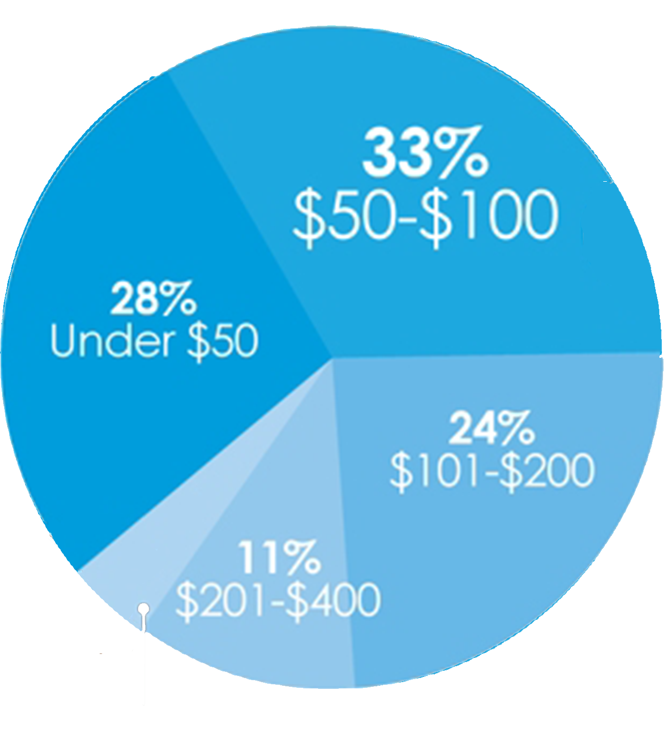
Gen Z / iGeneration 2001 -
Weekly Spending Money
62% prefer to spend their money on an experience over purchasing something material
89% consider themselves price-conscious shoppers

Slide 86
jsandoval@stphilipscathedral.org
Archdeacon Juan Sandoval

